Slide 1
The Long Run: Discussions on Growth
ECON 301

Slide 2
The Future of Technological Progress
Nobody knows with certainty the future of technological progress.
R&D as a process is a very slow, incremental process with no guarantee of any progress.
Yet, observing the rapid speed of progress being made in certain sectors, we may expect technological progress to continue over the foreseeable future.
For instance, over the last 5~6 decades, progress in the computing world held close to Moore’s law.

Slide 3
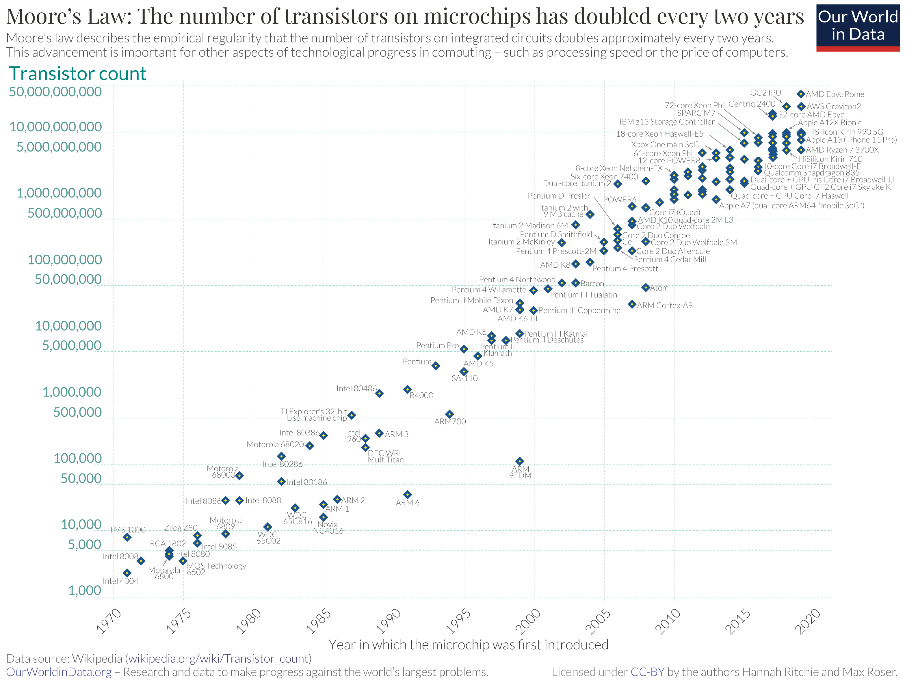

Slide 4
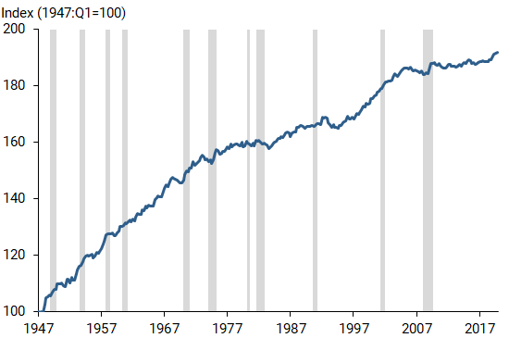
Total Labor Productivity of the US
Fernald and Li’s study on US TFP growth show that the average growth rate has declined…
1947~1973: 2%
1996~2004: 0.6%
2004~2019: 0.4%
Seems that technological progress is slowing down?

Slide 5
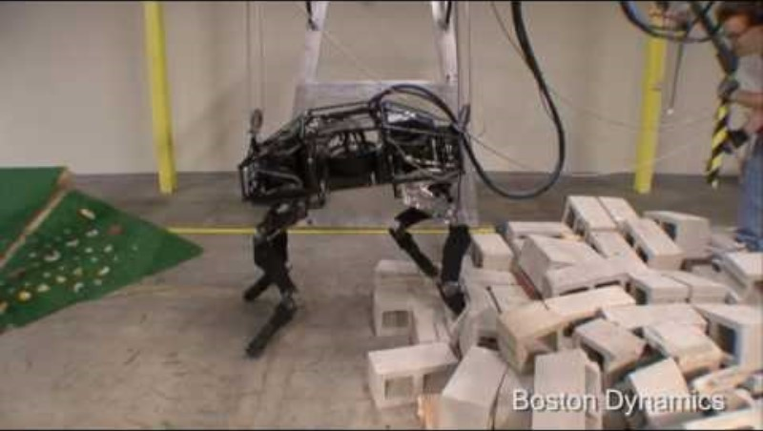
Boston Dynamics: 2009

Slide 6

Boston Dynamics: 2021

Slide 7
Measurement Errors
Both the 2009 and 2021 version of Boston Dynamic’s robots may be measured the same output, “robot dog.”
Growth accounting will measure the differences in the quality of output, but there will inevitably be some degree of measurement errors.
A deep dive into growth accounting show measurement errors to exist.
But can only explain a small portion of the decrease in measured productivity growth.

Slide 8
Lack of General-Purpose Technology
One potential explanation is that recent technological progress is not as significant as the progress of the past.
General-purpose technologies that have applications in a vast number of fields and products may be happening at a much slower pace.
Control over electricity, or the invention of the internal combustion engine both transformed the world.
If modern advances are not as transformative, it is natural that our measure of technological progress slows down.

Slide 9
Speed of Diffusion
On the other hand, Artificial Intelligence may have the potential to be even more transformative than electricity.
The current low productivity may be attributed to the slow process of adoption and diffusion.
Throughout history, we have seen countless cases in which a new form of technology is introduced, only to be snubbed by even the so-called experts.
For instance…

Slide 10
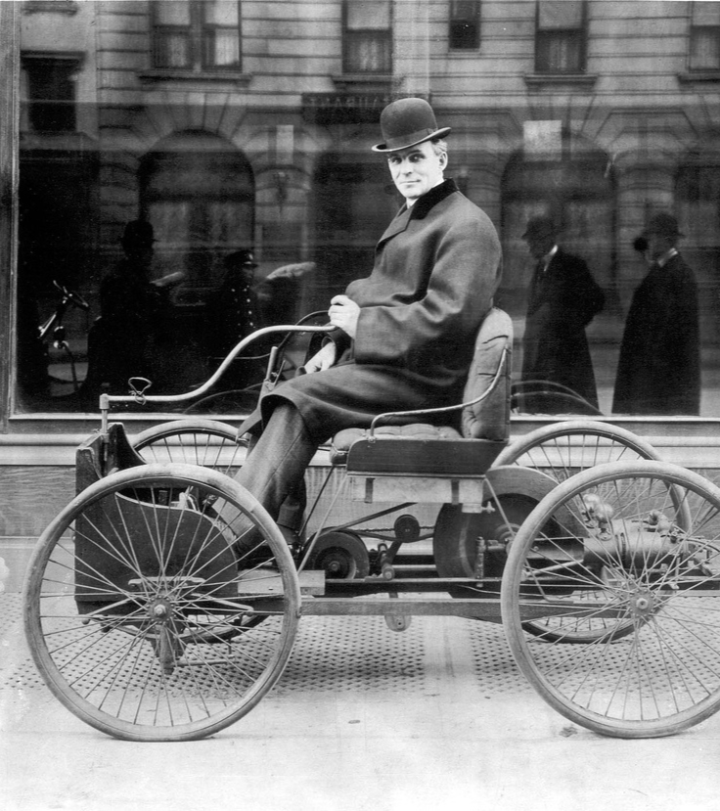
Henry Ford (1896)
“The horse is here to stay but the automobile is only a novelty–a fad.”
President of the Michigan Savings Bank (1903)
Declined to invest in Ford.
The global automotive industry is estimated to be worth $2,810 billion as of 2022.

Slide 11
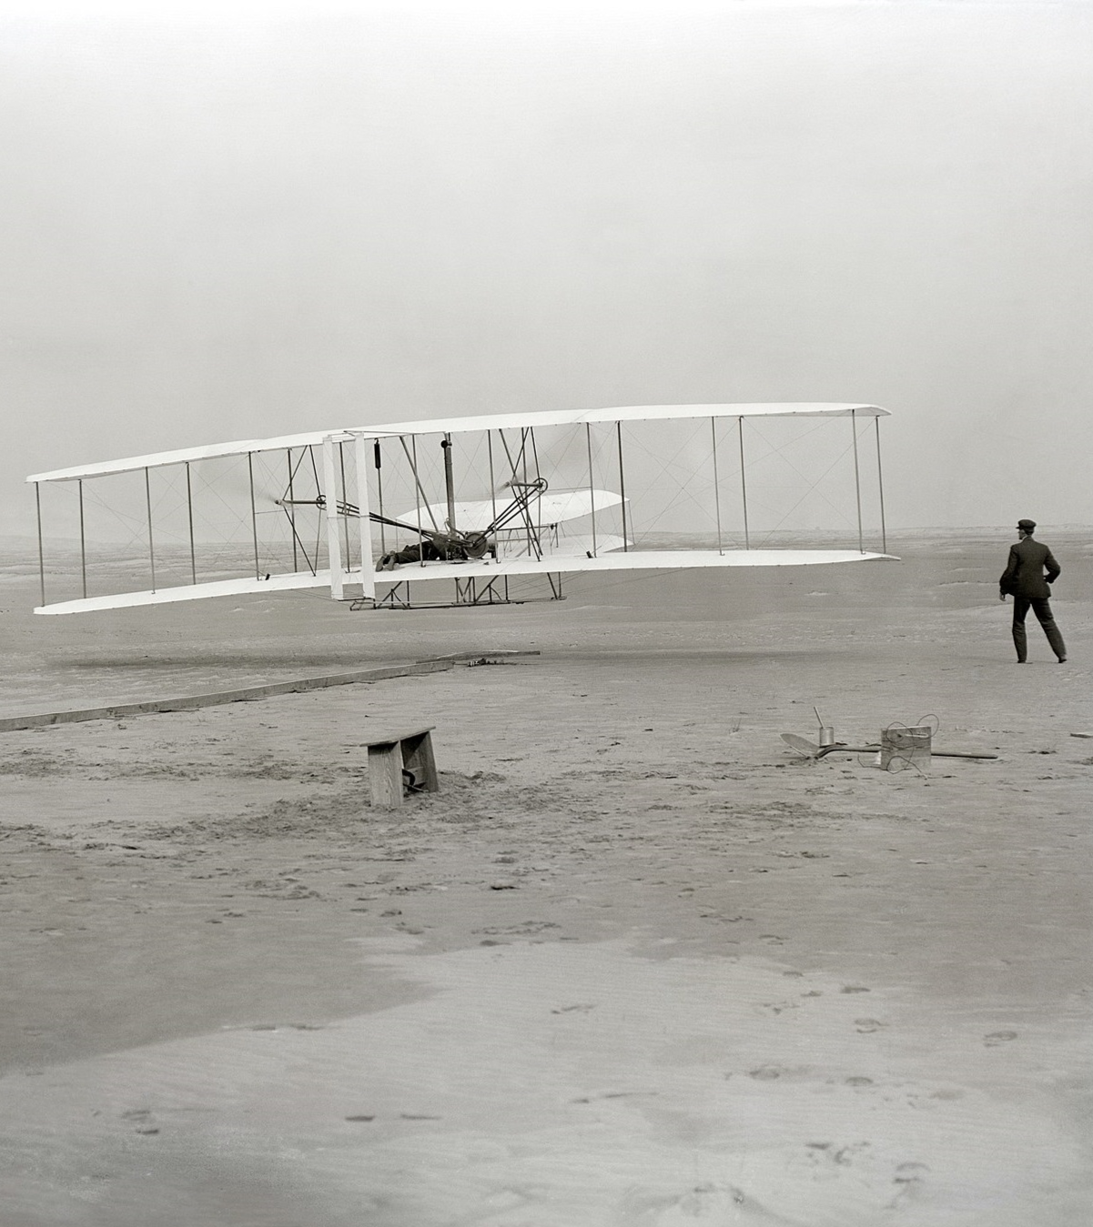
Wright Brothers (1903)
“Airplanes are interesting toys but of no military value”
Ferdinand Foch (1904)
Chief of Staff, French Army
“If we lose the war in the air, we lose the war and we lose it quickly.”
Bernard Montgomery (1940s)
Field Marshal, British Army

Slide 12
Technological Progress and Unemployment
Technological progress may not be purely “good.”
Historically, the industrial revolution was one of the most pivotal moments in technological progress.
At the time, groups of English workers textile workers called Luddites, destroyed machines that they perceived as a threat to their employment.
In France, workers would destroy machines by deliberately inserting their sabots (wooden shoes) in machines, which lead to the term Saboteur.

Slide 13
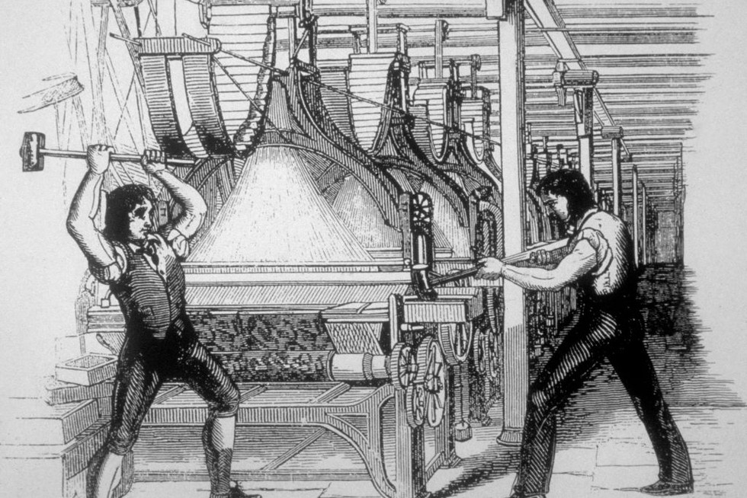
Technological Progress and Unemployment

Slide 14
Technological Progress and Unemployment
There is little evidence that technological progress leads to a higher level of unemployment…
At the societal level, technological progress led to higher standards of living, and a lower unemployment rate.
Historically, periods with slower rates of technological progress is linked to higher unemployment rates.
However, there is no guarantee that historical trends will continue to hold in the future.

Slide 15
Technological Progress and Unemployment
It may be true that certain sectors of the economy will experience technological unemployment.
Studies have found that the introduction of robots in factories led to a higher level of unemployment in local labor markets.
It is hard to predict if the increase in productivity will lead to job creations in other areas of the economy.
It is even harder to predict which sectors will be impacted, and to what extent employment would be affected.

Slide 16

Emily Howell (2016)

Slide 17
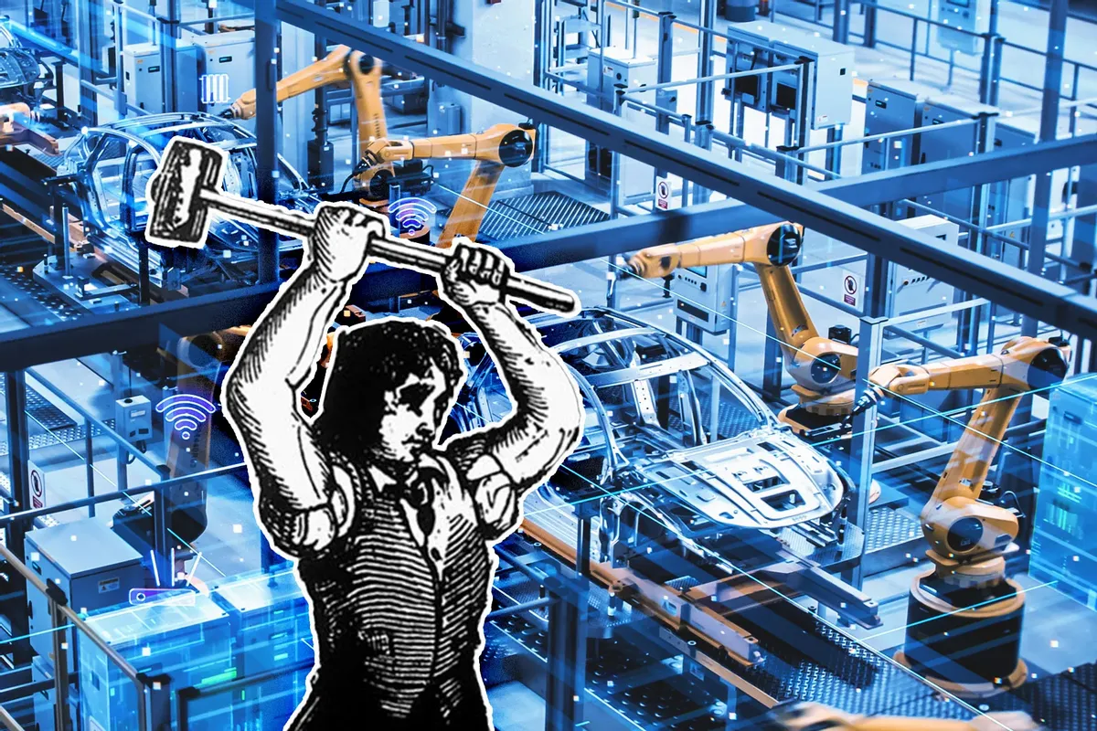
Technological Progress and Unemployment

Slide 18
Growth and Inequality
Growth in real life does not necessarily mean the creation of “more of the same.”
Growth is naturally a process of creative destruction.
Some existing professions and products will become obsolete, and completely new alternatives will arise.
Individuals working in the sectors that disappear will most likely lose their jobs, and those who happen to have the skills required in the new sectors will enjoy higher wages.

Slide 19
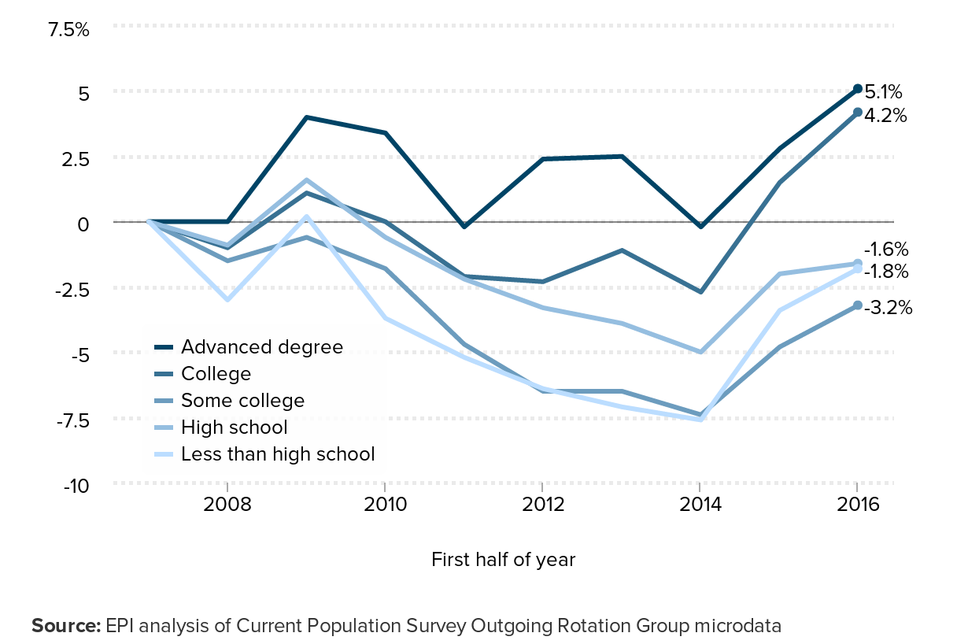
Growth and Inequality

Slide 20
Growth and Inequality
Overall, the wage inequality on the basis of educational attainment in the US has increased over time.
Between 1973 and 2017, the relative wage of workers with a college degree increased to 20% higher than that of high-school graduates.
One potential cause is globalization and outsourcing of low-skill work to countries with lower cost of labor.
Skill-biased technological progress heavily favoring high-skilled, highly educated workers is also a likely cause.

Slide 21
Measuring Inequality
Find the individual with the lowest income, find what percent of the economy’s income they have, and plot the point on the chart.
Repeat this process with everyone from the poorest to richest.
Link the points with a single graph.
1
Share of Income
Share of Population
(From Lowest to Highest Income)
0
1

Slide 22
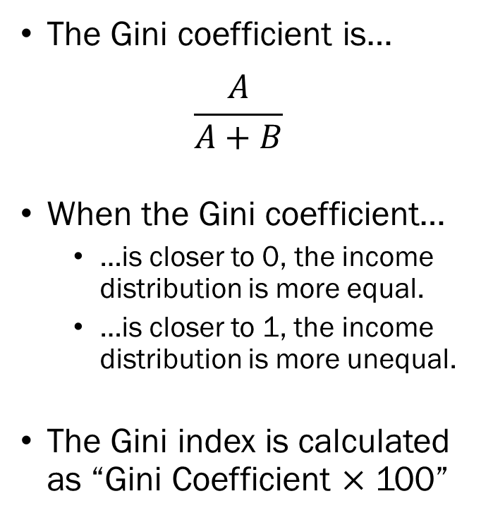
Measuring Inequality
The Gini coefficient is…
$$\frac{A}{A+B}$$
When the Gini coefficient…
…is closer to 0, the income distribution is more equal.
…is closer to 1, the income distribution is more unequal.
The Gini index is calculated as “Gini Coefficient $×$ 100”
1
Share of Income
A
B
Share of Population
(From Lowest to Highest Income)
0
1

Slide 23
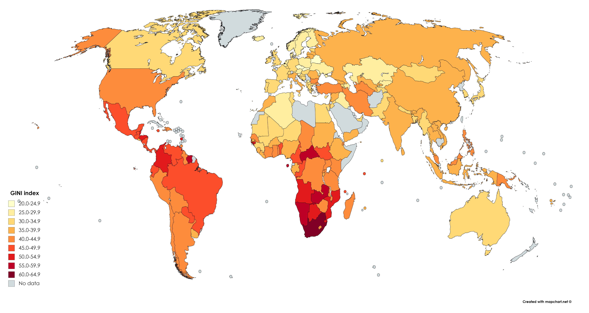
Comparison of Gini Indices

Slide 24
Growth and Externalities
Other than the challenges that we discussed, a new challenge to growth is gaining traction, externalities.
One of the most significant externalities from economic development is the increased emission of greenhouse gas.
The human-related emission of CO2 has increased…
1870: 533 million tonnes was attributed to human activity.
1950: 5.6 billion tonnes was attributed to human activity.
2022: 37.1 billion tonnes was attributed to human activity.
Meanwhile, the global average temperature increased…

Slide 25
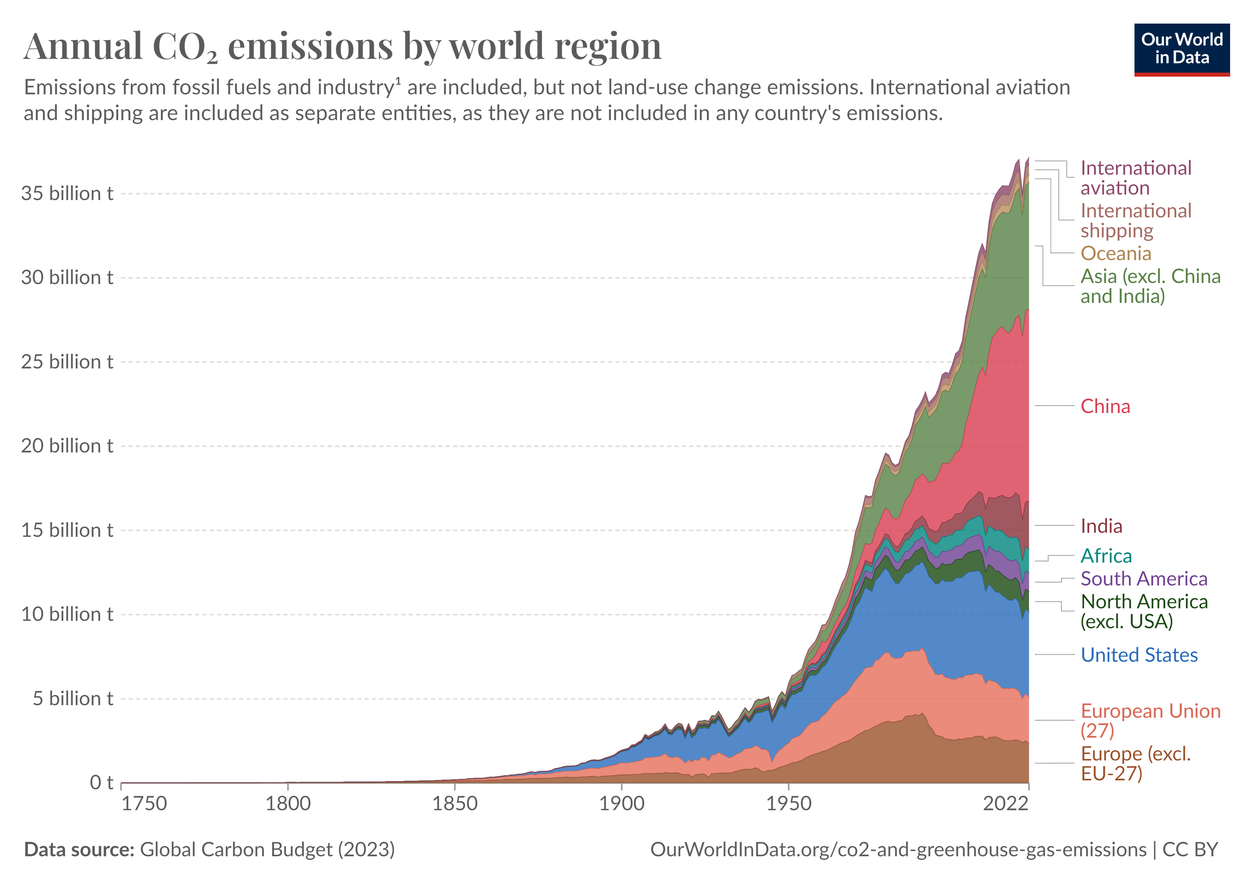

Slide 26
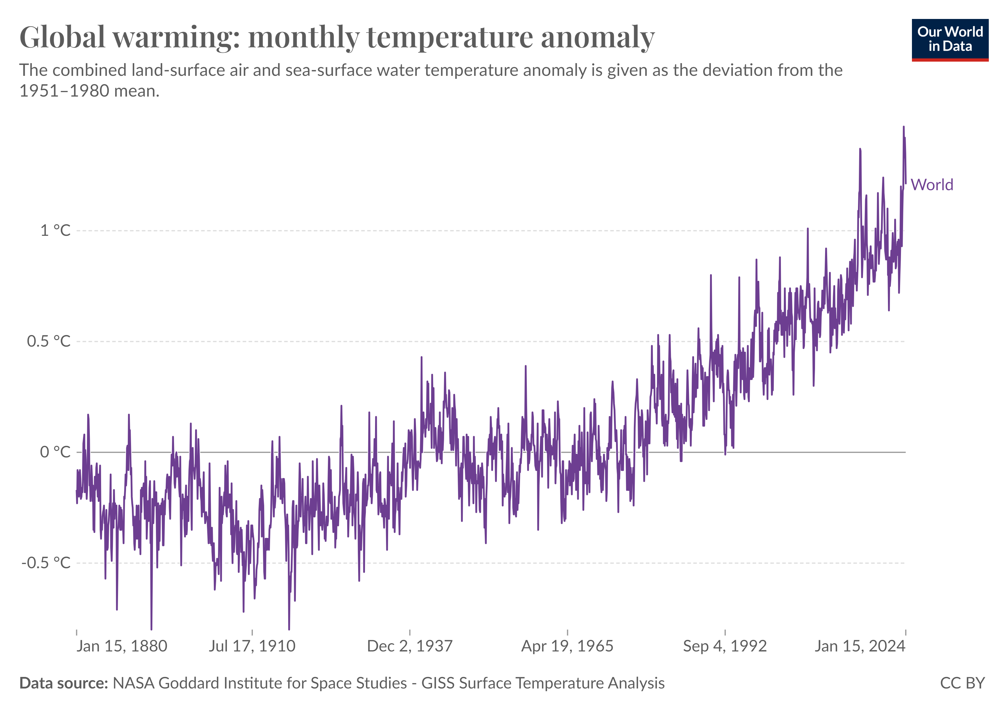

Slide 27
Growth and Externalities
The current benchmark is to limit the global average temperature to no more than 1.5C (2.7F) above the pre-industrial level.
In order to achieve this goal, the Intergovernmental Panel on Climate Change (IPCC) estimates that we need net zero emissions by 2050.
Economists agree that the best method to achieve this goal is to internalize the externalities by putting a price on carbon emissions.

Slide 28
Roadblocks to Policy
First, climate change is a relatively new issue, many countries are reluctant to take any action, and many individuals tend to distrust scientists.
Second, the high cost to pay in the present for a benefit in the very far future is hard to sell to politicians whose own interests depend on “getting elected this cycle.”
Probably most importantly, applying the same standard to developed countries and emerging economies may be seen as deeply unfair.

Slide 29
